Slide 1
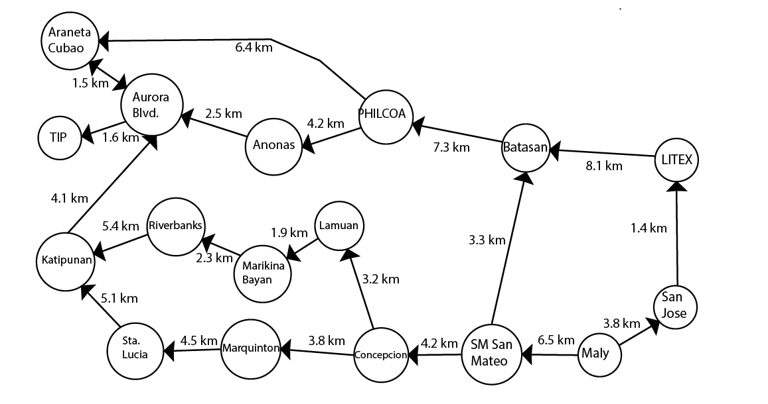

ROUTE 1
Maly to Marikina Bayan: 25 PHP
Marikina Bayan to TIP: 15 PHP

Slide 2
ROUTE 2
Maly to PHILCOA: 25 PHP
PHILCOA to Araneta Cubao: 15 PHP
Araneta Cubao to TIP: 11 PHP

Slide 3
ROUTE 3
Maly to Sta Lucia: 35 PHP
Sta Lucia to TIP: 20 PHP

Slide 4
ROUTE 4
Maly to PHILCOA: 25 PHP
PHILCOA to Anonas: 13 PHP

Slide 5
ROUTE 5
Maly to San Jose: 12 PHP
San Jose to Cubao: 50 PHP

